Slide 2
The Magic of Reading!
Polar Bear Polar Bear
http://www.youtube.com/watch?v=qU97IXT8MIs
Notes:
This is two-minute film of a father reading to his baby.
The baby has obviously heard the story many times and can distinguish between the text and the narrator.
The patterns and the rhythms of the story are embedded and the baby knows when his father is reading and when he is making the animal noises.

Slide 3
The Power of Reading!
Creating a love of reading in children is potentially one of the most powerful ways of improving academic standards in school.
There can be few better ways to improve pupils chances in school, or beyond in the wider world than to enable them to become truly independent readers.
Notes:
If children are happy to read, they are more likely to do so when they have to as well as when they want to.

Slide 4
Let’s Look at the Facts… https://readingagency.org.uk
There is a difference in reading performance equivalent to just over a year's schooling between young people who never read for enjoyment and those who read for up to 30 minutes per day.
Children who read books often at age 10 and more than once a week at age 16 gain higher results in maths, vocabulary and spelling tests at age 16 than those who read less regularly.
DfE analysis suggests that if all pupils in England read for enjoyment every day or almost every day, the boost to Key Stage 2 performance would be the equivalent of a rise of eight percentage points
Notes:
https://www.gov.uk/government/uploads/system/uploads/attachment_data/file/284286/reading_for_pleasure.pdf
Have this open in browser and divert parents attention to it. I have also tweeted this link.
In addition to the statistics displayed, the PIRLS 2006 data of school children aged 9 to 10 shows that those who read stories or novels outside of school ‘every day or almost every day’ score significantly higher (with a standardised overall score) compared to those that do so once or twice a week.

Slide 5
Reading Memories
Do you have a good childhood memory about books and reading?
Do you have an unpleasant memory?
It is the conditions and feelings associated with your good memory that should be recreated for reading with your child.
Notes:
It is likely that most positive responses will relate to being read to, at bedtime or at school.
Negative memories are often associated with having to read aloud in class.

Slide 6
Reading
Success in reading is fundamental to success in school.
Reading is all about acquiring meaning; for enjoyment, information and understanding.
It is not a performance.
It is not a test.
Every time you finish a book - do always choose a harder one next time?
Notes:
Most aspects of the curriculum rely upon reading to some extent;

Slide 7
Four Key Aspects of Reading
Word recognition (phonic knowledge/awareness, ‘highway code’ of reading e.g. left to right)
Reading fluency (fluency within every band, phrases, pace and punctuation, reading in chunks with meaning, reading that sounds like talking!)
Using strategies when reading texts (flexible, self-monitoring and self-correcting)
Language, reading comprehension and enjoyment (understanding, enjoyment is goal of reading, self-directed, self-motivated)

Slide 8
Decoding v Comprehension
In the mind of pupils, decoding seems to have a much bigger profile than comprehension (barking at print!).
They think decoding rather than comprehension is the main point of reading.
Studies show that one in ten pupils who decode adequately experience comprehension problems when reading texts (i.e. 3 children in every class!)
Accurate decoding is crucial but still does not guarantee comprehension.

Slide 9
Understanding (Comprehension)
Being able to read does not mean you understand what you read.
Your child might sound like a good reader but may not necessarily understand what the text means.
The best way to develop understanding is to talk about texts.
The next slide is easy to read – does anyone understand what it means?

Slide 10
An extract taken from a computer manual
According to the previous ATA/IDE hard drive transfer protocol, the signalling way to send data was in synchronous strobe mode by using the rising edge of the strobe signal. The faster strobe rate increases EMI, which cannot be eliminated by the standard 40-pin cable used by ATA and ultra ATA.
Notes:
Ask parents to read the slide in their heads.
This slide shows that the ability to read aloud well is no indication of understanding.
Reading comprehension has to be taught.
Language has to be taught, defined, used and understood.

Slide 11
Understanding (Comprehension)
Finding information on the page.
Being able to find information that is not on the page. (Inference - Looking for clues)
Thinking about situations and predicting what might happen.
Putting yourself in a character’s shoes and understanding what is going on from their viewpoint.
Book talk to make your child think.
Notes:
Text Comprehension consists of the following:

Slide 12
Reading in School The Teaching of Reading
Phonics – KS1
Shared reading – KS1 and KS2
Guided Reading – KS1
Whole Class Reading – KS2
Independent reading - KS1 and KS2
Personal reading
Focused reading activities
Reading across the curriculum
Class novels and stories
School readers Home readers
The hearing of reading is NOT the teaching of reading
Notes:
So what does Reading look like at Crudgington?
Give a brief overview of the function of each of the above aspects of the teaching of reading in school.
Explain that all of these are part of the teaching of reading.
Explain that sometimes, as parents, there is an expectation that children are heard reading often in school. This may be the case for some, but not all children. The hearing of reading is not the same as the teaching of reading.
Explain the school policy and expectations about home reading – in general. Details to follow,

Slide 13
Fluency and Reading Comprehension
Even if we read accurately, we will have problems beyond the early years if we fail to read in phrases so that ‘reading sounds like talking’.
Word by word reading often means the start of a sentence can’t be integrated with the end.
Some pupils read too quickly so that comprehension suffers.

Slide 14
Implications of Poor Comprehension
Pupils who fail to understand adequately what they read…
Are less inclined to be motivated readers and so read less and have less practice in both word reading and comprehension
Tend to read less challenging books so will have fewer opportunities to develop vocabulary and improve general knowledge
Obtain significantly lower scores on national assessments in English, Maths and Science
A failure to develop a high level of comprehension skill creates a severe obstacle to educational and life attainment
Notes:
Boys who read 3 pages of a book and then put it back!
We have a moral duty!

Slide 15
Stamina and Fluency
Reading stamina is a child's ability to focus and read independently for extended periods of time without being distracted or without distracting others.
Fluency is the ability to read a text accurately, quickly, and with expression. Fluency is important because it provides a bridge between word recognition and comprehension. When fluent readers read silently, they recognise words automatically. When reading aloud, fluent readers read in phrases and add intonation appropriately.
90% of comprehension problems are due to fluency.

Slide 16
Why is it important?
Stamina and fluency help to embed a love of reading – if it is less laborious, it’s more enjoyable!
Reading assessments are long and require a great deal of concentration to remain focussed and on task. The end of KS2 Reading SAT paper required the children to read three challenging texts and answer questions on them in a 1 hour time period.
Reading is a life-long skill – being a fluent reader who can read for a prolonged length of time prepares children for the future.

Slide 17
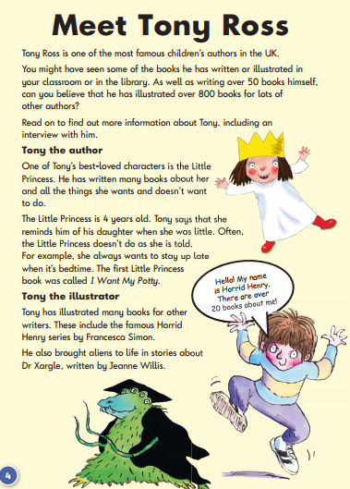
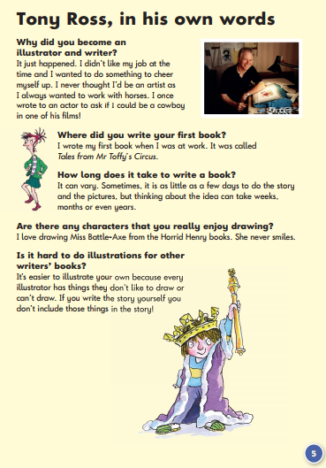
Notes:
KS1 Reading Test
Show the slides containing KS1 and 2 reading test texts.
Outline how lengthy they are and how little time children have to read and answer questions about the text.

Slide 18
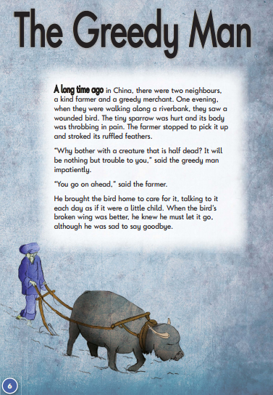
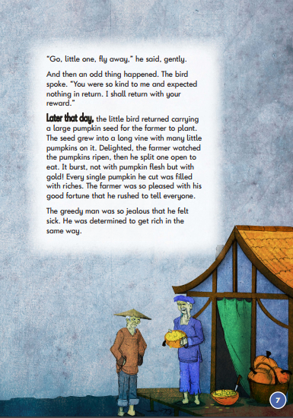
Notes:
KS1 Reading Test

Slide 19
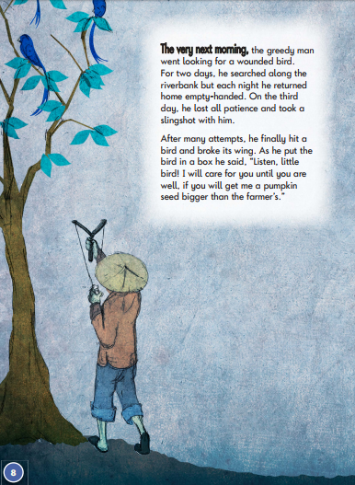
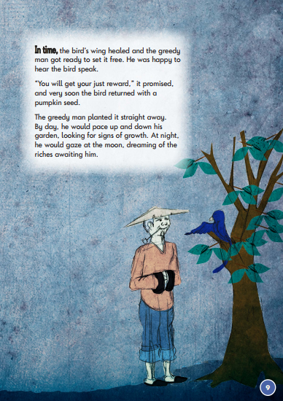
Notes:
KS1 Reading Test

Slide 20
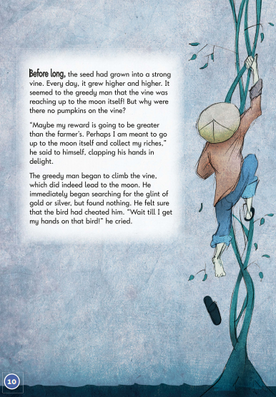
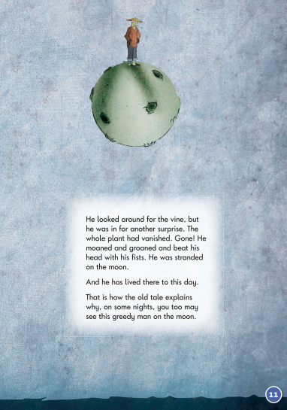
Notes:
KS1 Reading Test

Slide 21
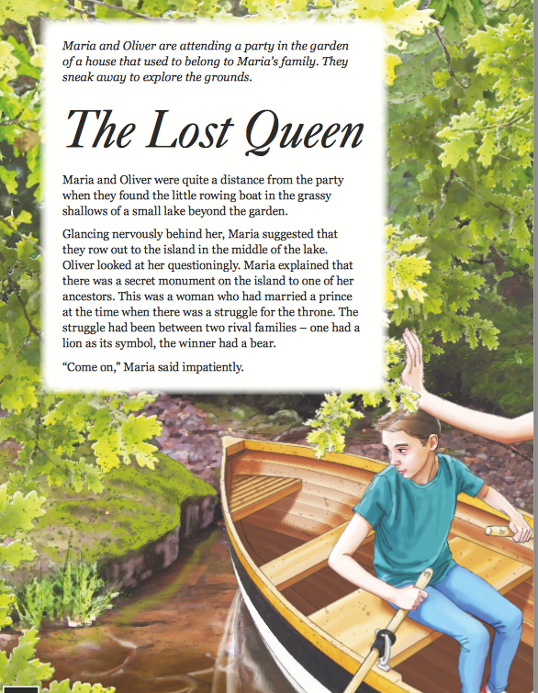
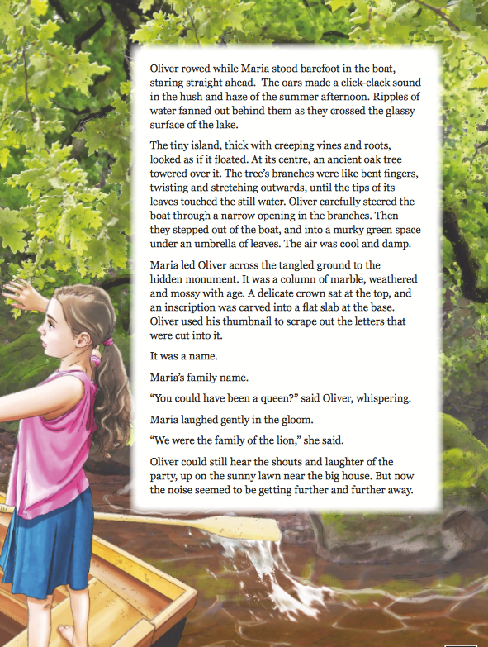
Notes:
KS2 Reading Test

Slide 22
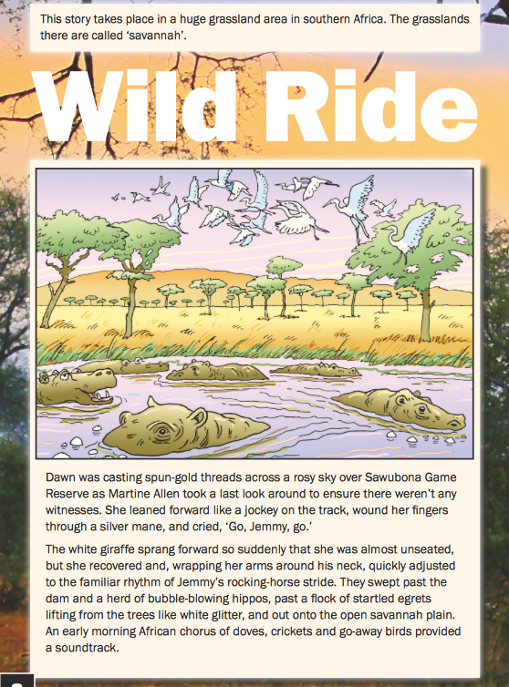
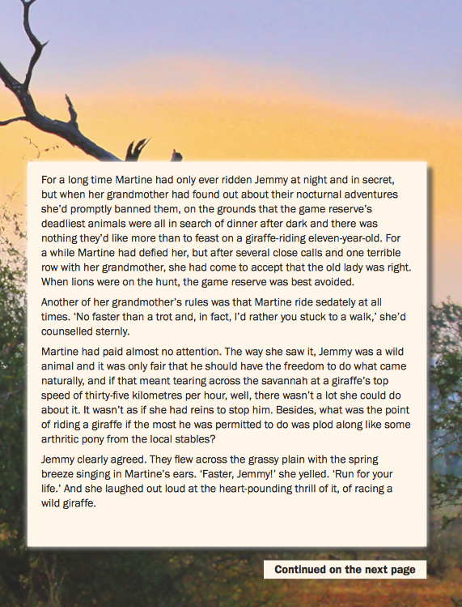
Notes:
KS2 Reading Test

Slide 23
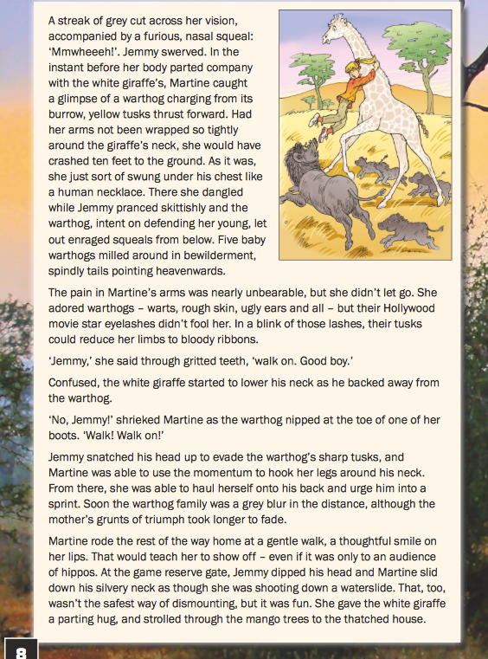
Notes:
KS2 Reading Test

Slide 24
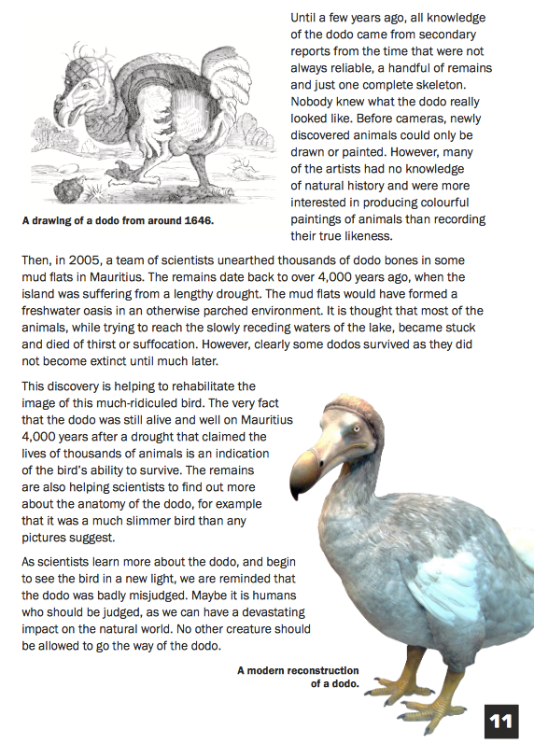
Notes:
KS2 Reading Test

Slide 25
Subvocalisation – the ‘inner voice’
Subvocalisation is essential to read and comprehend well.
Expert speed readers still do it – they just do it faster than others!
It’s not usually possible to comprehend what you’re reading without using that inner voice.
The inner voice still uses punctuation and elements of expression in order to aid comprehension.
Notes:
Children who read often, quickly develop their inner voice over. It is this inner voice which helps to develop comprehension skills.

Slide 26
Magic
Read this to yourself. Read it silently.
Don’t move your lips. Don’t make a sound.
Listen to yourself. Listen without hearing anything.
What a wonderfully weird thing, huh?
NOW MAKE THIS PART LOUD!
SCREAM IT IN YOUR MIND!
DROWN EVERYTHING OUT.
Now, hear a whisper. A tiny whisper.
Now, read this next line with your best crotchety-old-man voice:
‘Hello there, sonny. Does your town have a post office?’
Awesome! Who was that? Whose voice was that?
It sure wasn’t yours!
How do you do that? How?! Must be magic!

Slide 27
Practical Activities for Developing Fluency and Stamina
Modelled Reading
Repeated Reading
Echo Reading
Choral Reading
Keep to the Beat
It’s not what you say, it’s the way that you say it!
Expressive Punctuation
Notes:
Explain that you will talk through each of these points to use at home.

Slide 28
Modelled Reading
‘Strictly Come Reading’
Take it in turns to listen to one another read, providing marks out of 10 for each other’s reading. Provide feedback on what was good e.g. expression, phrase reading etc.
Listen to audio books, whilst following the texts.
Watch videos of poets reading their own material.
Adult read a page using appropriate expression, child reads the following page mirroring what was heard before.

Slide 29
Repeated Reading
Research over the past two decades has identified repeated reading as the key strategy for improving children’s fluency skills (NICHD, 2000).
Give children the opportunity to:
-read and then re-read the same text;
-re-read favourite books and familiar poems;
-re-visit easier texts;
-share texts they read when they were younger;
-practise silently reading familiar material, using their ‘inner voice’.

Slide 30
Echo/Choral Reading
Echo Reading
Read a line and ask your child to read a line back to you in exactly the same way. Practise this with pairs of lines/verses from a poem.
Choral Reading
Read together/as a family. You will find that the children naturally mirror the adult’s voice, using expression in the same places. It also makes children less apprehensive about making a mistake as they are not reading alone.

Slide 31
Keep to the Beat
Raps are a great way to improve fluency and develop rhythm!
Gran was in her chair, she was taking a nap,
When I tapped her on the shoulder to see if she could rap.
Gran can you rap? Can you rap? Can you, Gran?
And she opened one eye and she said to me, Man,
I’m the best rapping Gran this world’s ever seen,
I’m a tip-top, slip-slap, rap-rap queen.
And she rose from the chair in the corner of the room
And she started to rap with a bim-bam-boom,
And she rolled up her eyes and she rolled round her head
And as she rolled by, this is what she said,
I’m the best rapping Gran this world’s ever seen,
I’m a nip-nap, yip-yap, rap-rap queen!

Slide 32
It’s not what you say, it’s the way that you say it!
Lucy borrowed my new bike.
Read it as if:
You’ve got other bikes.
Lucy borrowed my new bike.
You don’t think she planned to give it back.
Lucy ‘borrowed’ my new bike.
You can’t believe Lucy would do such a thing.
Lucy borrowed my new bike.

Slide 33
Expressive Punctuation
Abcd. Efghi. Jklmn. Opq. Rstuvw. Xyz.
Abc? Def? Ghijklm? Nopq? Rstu? Vwxyz?
Ab, cdef. Ghijk, lmnop. Uv, wxyz.
Ab! Cdefg? Hijkl! Mnopq. Rstuv. Wxyz?
Ab? Cdefg? Hij – klmno – pqrstu. Vwxyz!
A, bcd, efgh. I. Jklm, nopqr. Stuvw? X! Yz?

Slide 34
Other Strategies
I read a page, you read a page.
Follow the leader – I’ll read, you follow.
Record our reading.
Silly voices – read in a whisper, squeaky voices.
Direct speech detectives – play different characters.
Read in the dark – with a torch.
Guess the next word – stop reading mid-sentence.
Change the word – spot which one has changed.

Slide 35
Reading at Home – Enjoy!
Make reading visible; have books available in your home
Share books every day;
Boys need to see that reading is something men do.
Talk about books.
Sit and listen – avoid doing chores around the reader.
Respect choices.
Notes:
Respect choices – reading the computer (Bug Club) or comics or sports magazines is still reading and is fine – but it is the role of teachers and parents to encourage a variety of reading: non-fiction, novels etc.

Slide 36
Role of Parents/Carers and the Home Environment
Evidence suggests that parents and the home environment are essential to the early teaching of reading and fostering a love of reading. Key findings from the evidence include:
• Parental involvement in a child’s literacy has been reported as a more powerful force than other family background variables, such as social class, family size and level of parental education (Flouri and Buchanan, 2004 – cited in Clark and Rumbold, 2006);
• Children whose home experiences promote the view that reading is a source of entertainment are likely to become intrinsically motivated to read (Baker, Serpell and Sonnenschein, 1995 – cited in Clark and Rumbold, 2006);
• Children are more likely to continue to be readers in homes where books and reading are valued (Baker and Scher, 2002 – cited in Clark and Rumbold, 2006).

Slide 37
Children whose parents reported that they had read a book with their child “every day or almost every day” or “once or twice a week” during the first year of primary school, performed higher in PISA 2009 than children whose parents reported that they had done this “never or almost never” or “once or twice a month”.

Slide 38
What to do if your child is stuck
Use phonics first. What sound does the word begin with? Can you say the sounds in the word? Blend them together. Have we heard that word before?
Read to the end of the sentence. What would make sense?
What is the text about – what might fit here?
Does it sound right?
Look at the picture. Does it help?
Notes:
Explain that we know there are times when children will be struggle to decode a new word, or to decipher its meaning. There are things we can do to help them along.
Talk through each strategy and explain what each will do to help the child decode/clarify a word that they cannot read/understand.

Slide 39
Independent Strategies by Jill Marie Warner
When I get stuck on a word in a book, There are lots of things I can do. I can do them all, please, by myself; I don't need help from you. I can look at the picture to get a hint. Or think what the story's about. I can "get my mouth ready" to say the first letter. A kind of "sounding out". I can chop up the words into smaller parts, Like on or ing or ly, Or find smaller words in compound words Like raincoat and bumblebee.
I can think of a word that makes sense in that place, Guess or say "blank" and read on Until the sentence has reached its end, Then go back and try these on: "Does it make sense?" "Can we say it that way?" "Does it look right to me?" Chances are the right word will pop out like the sun In my own mind, can't you see? If I've thought of and tried out most of these things And I still do not know what to do, Then I may turn around and ask For some help to get me through.

Slide 40
How to use these strategies at home
John let his pet frog go.
It ******across the grass.
What is the first sound?
It h***** across the grass.
What would make sense?
It hopping across the grass.
Does that sound right?
It hopped across the grass.

Slide 41
Book Talk
Do you like this book?
Do you like this character?
It’s a good story isn’t it?
Do you like reading?
Are you good at reading?
Do you like this kind of story?
Change these questions so that the answers cannot be yes or no.
What do you like about this book?
What do you think of this character?
Why do you think this is a good story?
What’s great about reading?
Why are you a good reader?
What is it about these stories that you like so much?
Notes:
Briefly explain the difference between an open and a closed question.
Explain that open questions will generate discussion which will lead to better understanding whereas closed question will only generate a one word answer.
Click to reveal possible alternatives when the parents have had a go.

Slide 42
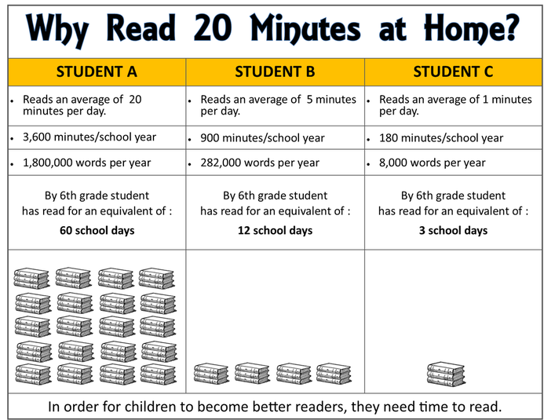
Reading at Home - Expectations
Notes:
Read the table statistics, pointing out that 6th grade is Primary leavers age.
Our expectations for home reading is any 5 nights per week for 15-20 minutes from EYFS – Y3 and 30 minutes from Y4.
Explain that books will be changed 3 times a week until a book is so long that it can not be read in two nights.
Books will be changed Monday, Wednesday, Friday.
Shorter books should be read on both days (so repeated), once books get to 30 pages, read 15 pages one night, 15 the next.
Teachers should say at this point that our advice would be no games console until half an hour or reading has been done.
As a parting note, please stress the power of bedtime stories – the parent reading to their child as part of their bedtime routine, and joining the library and letting the chn be involved in choosing the books – making it a special time.

