Slide 1
^{Monday, 1st February}

Slide 2
Review:
Copy and place commas correctly in the sentences below: (Consider the different uses for commas)
Two stunning red parrots cackled with laughter.
Hopping comically they made their way to the edge of the branch.
Because they were so clever they had learnt how to speak to humans!

Slide 3
Answer:
Two, stunning, red parrots cackled with laughter.
Hopping comically, they made their way to the edge of the branch.
Because they were so clever, they had learnt how to speak to humans!

Slide 4
https://www.youtube.com/watch?v=eDkpVwrhYfo
What does a playscript look like/include?
Speaker’s names written on the left followed by a colon
• Dialogue written without inverted commas
• Stage directions written in brackets.
• Playscript divided into scenes
• Each scene is introduced
• Characters listed at the beginning
• Use of a narrator to tell the story, give information or comment on the action

Slide 5
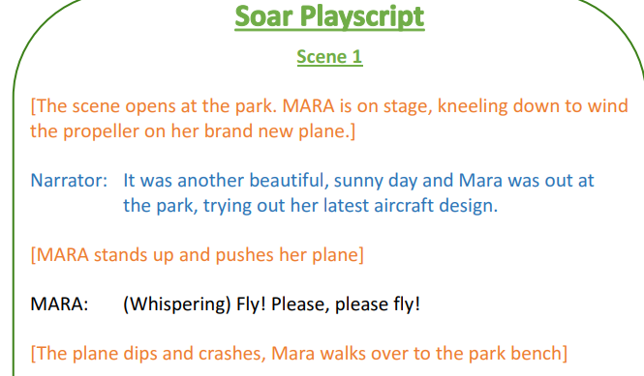
This is what your playscript should look like in it’s final draft.

Slide 6
Using your plan, write up your playscript!
Lucas Shouts Stay back.. Stay back!
Scene 2: Mara meets Lucas
(Lucas’s flying machine falls onto the table in front of Mara. Lucas stumbles out of his aircraft as Mara stands still and stares).
Lucas: (Shouts) Stay back… stay back!!
Mara: (Shocked) Woah there, I’m not going to hurt you!

