Slide 1
^{Tuesday, 2nd February}

Slide 2
Review:
Copy and place inverted commas correctly:
Has anyone tried this cake yet? It’s amazing! Exclaimed Claire.
Sat in her favourite hiding spot, Sophia whispered to herself I hope I win this game of hide and seek!
Look at the beautiful clouds in the sky Philip sighed Mom.

Slide 3
Answer:
“Has anyone tried this cake yet? It’s amazing!” Exclaimed Claire.
Sat in her favourite hiding spot, Sophia whispered to herself “I hope I win this game of hide and seek!”
“Look at the beautiful clouds in the sky Philip” sighed Mom.

Slide 4
https://www.youtube.com/watch?v=eDkpVwrhYfo
What is a non-chronological report?
Discuss the meanings of the vocabulary – prefix ‘non’ and ‘chronological’. A nonchronological report is a non-fiction report that is not written in time order. They are factual, use technical language and are organised into different sections using sub-headings.
Today we will be looking at some of the features of a non-chronological report.
*Look at examples of non-chronological reports*

Slide 5
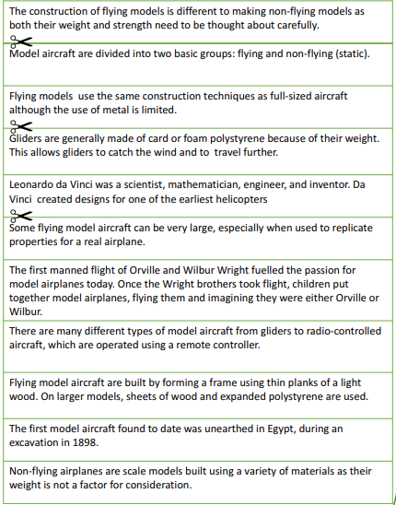
1. What are model aircraft made from?
2. The different types of model aircraft.
3. The history of model aircraft.
3
1
1
2
2
2
2
3
1
1
3

Slide 6
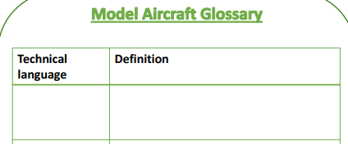
Use a dictionary/online dictionary to find the meanings of these technical terms from what we read through previously.
https://dictionary.cambridge.org/
Static
Glider
Manned
Radio controlled
Operated
Expanded
Unearthed
Scale model

