Slide 1
^{Wednesday, 3rd February}

Slide 2
Review:
Identify and copy down any prepositions in the passage of text below. Prepositions can show time, place and cause! Challenge: For every preposition you find, state which type it is!
It was a cold, crisp, but sunny winters morning. Ice clung onto every leaf, cobweb, branch and blade of grass. Birds and mice huddled safely in the hollows of trees, as they needed to keep warm. Soon the temperature would rise and the animals could come out to play on the dewy grass. After that, they would start their adventures for the day, hunting for food. Because it was winter, it was harder to find many edible delights.

Slide 3
Review:
It was a cold, crisp, but sunny winters morning (TIME). Ice clung onto (PLACE) every leaf, cobweb, branch and blade of grass. Birds and mice huddled safely in (PLACE) the hollows of trees, as (CAUSE) they needed to keep warm. Soon (TIME) the temperature would rise and the animals could come out (PLACE) to play on (PLACE) the dewy grass. After (TIME) that, they would start their adventures for (CAUSE) the day, hunting for (CAUSE) food. Because (CAUSE) it was winter, it was harder to find many edible delights.
Answer:

Slide 4
https://www.youtube.com/watch?v=eDkpVwrhYfo
What is a non-chronological report?
Discuss the meanings of the vocabulary – prefix ‘non’ and ‘chronological’. A nonchronological report is a non-fiction report that is not written in time order. They are factual, use technical language and are organised into different sections using sub-headings.
Today we will be looking at some of the features of a non-chronological report.
*Look at examples of non-chronological reports*

Slide 5
We are going to be looking more into these three sub-headings for our non-chronological reports on model aircraft.
What are model aircraft made from?
The different types of model aircraft.
The history of model aircraft.
We are going to research these further today.

Slide 6
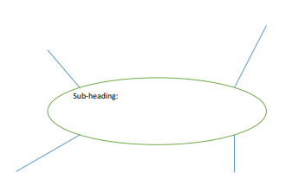
What are model aircraft made from?
The different types of model aircraft.
The history of model aircraft.
We are going to be safely searching on the internet for information based on these sub-headings.
Think carefully about your searches – instead of ‘model aircraft’ model aircraft fact for kids, or the different types of model aircraft facts.
You may want to draw a circle/thought bubble around each sub-heading then place your internet research around it.

