Slide 1
04.02.21

Slide 4
Circle the multiples of 5
12 35 40 57 95 70
2) Here are 15 cubes.
How many groups of 3 are there?
Here is an array.
How many groups of 4 are there?

Slide 5
Circle the multiples of 5
12 35 40 57 95 70
2) Here are 15 cubes.
How many groups of 3 are there?
Here is an array.
How many groups of 4 are there?
5
3

Slide 6
Alex has 11 flowers.
There are 5 pots of 2 and 1 flower remaining.
11 $÷$ 2 $=$ 5 remainder 1
If she plants 2 flowers in each pot.
How many pots can she fill?

Slide 7
What if Alex grouped her flowers into pots of 3?
There are 3 pots of 3 and 2 flowers remaining.
11 $÷$ 3 $=$ 3 remainder 2
How many pots can she fill?
How many flowers will be remaining?
Have a think

Slide 8
What if Alex grouped her flowers into pots of 4?
There are 2 pots of 4 and 3 flowers remaining.
11 $÷$ 4 $=$ 2 r 3
How many pots can she fill?
How many flowers will be remaining?
Have a think

Slide 9
Dora has 13 counters.
She arranges her counters into equal groups
and has some counters remaining.
How could Dora have arranged her counters?
Have a think

Slide 10
6 groups of 2 and 1 remaining
13 $÷$ 2 $=$ 6 r 1
4 groups of 3 and 1 remaining
13 $÷$ 3 $=$ 4 r 1
3 groups of 4 and 1 remaining
13 $÷$ 4 $=$ 3 r 1

Slide 11
2 groups of 5 and 3 remaining
13 $÷$ 5 $=$ 2 r 3
2 groups of 6 and 1 remaining
13 $÷$ 6 $=$ 2 r 1

Slide 12
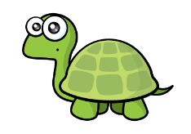
Have a think
19 divided by 5 is equal to 3 r 4
20 divided by 5 is equal to 3 r 5

Slide 13
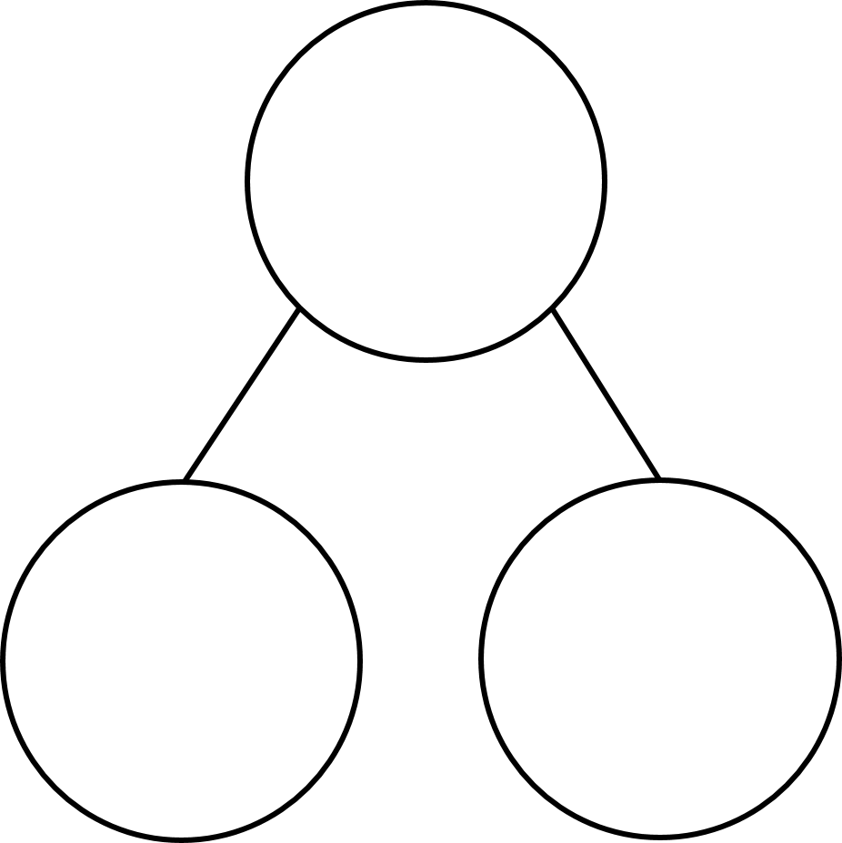
13 $÷$ 3 $=$
Complete the part whole models
5 $+$ 4 $=$ 10 $+$ 4 $=$
15 $+$ 4 $=$ 20 $+$ 4 $=$
25 $+$ 4 $=$ 30 $+$ 4 $=$
35 $+$ 4 $=$
73
73
3
60

Slide 14
87 ÷ 4 =
21
remainder 3
87
Tens | Ones
80
7
$÷$ 4
$÷$ 4
20
1 r 3

Slide 15
73 ÷ 3 =
24
remainder 1
Have a think
73
Tens | Ones
60
13
$÷$ 3
$÷$ 3
20
4 r 1

